Slide 1



dasboard sales phone
View in Power BI
Last data refresh:
4/18/2024 11:53:24 PM UTC
Downloaded at:
4/18/2024 11:55:46 PM UTC

Slide 2
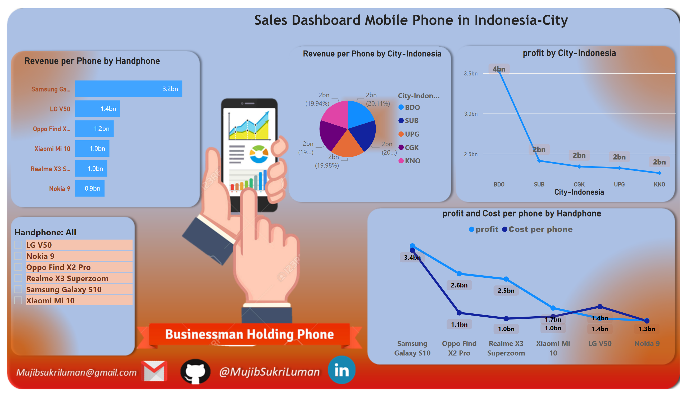
Page 1
Notes:
clusteredBarChart
No alt text provided
pieChart
No alt text provided
slicer
No alt text provided
lineChart
No alt text provided
lineChart
No alt text provided
textbox
No alt text provided

